Slide 1
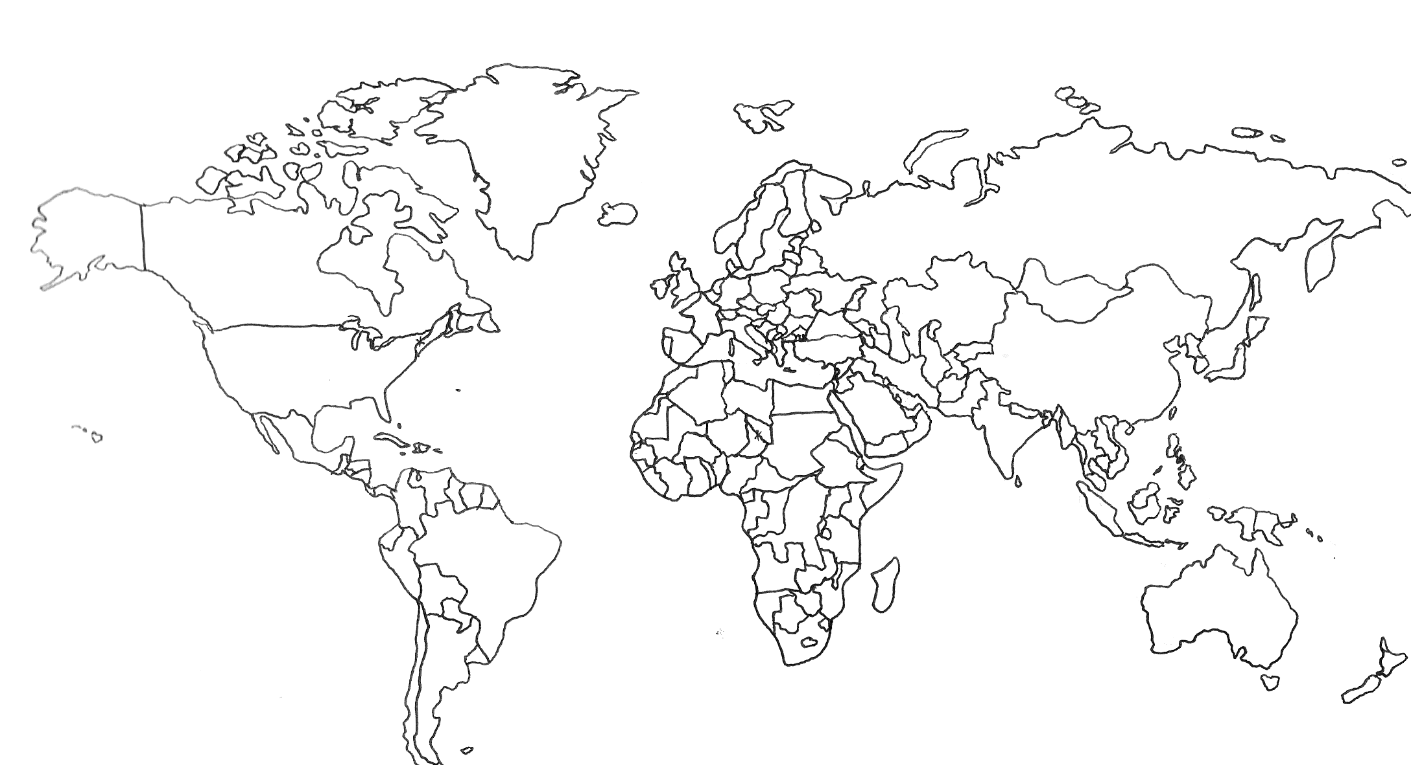

Kibrisa geldigim … god warum? ich mochte nicht hier
Sous la pluie mais beau tout de même, chère Ileana!
Buona giornata a te e a tutti!
Coridel Ent merilis full tracklist untuk debut mini album Jessica Jung yg akan segera rilis bulan Mei mendatang
no me lebante ahorita cuz I felt como si me kemara por dentro
jit fi la fin du mois de dece-mbre kan ljaw bared ktir wttalj

Slide 2
Code-mixing or Code-Switching is the mixing of two or more languages in a conversation or even an utterance.
Kibrisa geldigim … god warum? ich mochte nicht hier
Sous la pluie mais beau tout de même, chère Ileana!
Buona giornata a te e a tutti!
Coridel Ent merilis full tracklist untuk debut mini album Jessica Jung yg akan segera rilis bulan Mei mendatang
no me lebante ahorita cuz I felt como si me kemara por dentro
jit fi la fin du mois de dece-mbre kan ljaw bared ktir wttalj

Slide 3
Processing & Understanding Mixed Language Data
EMNLP-IJCNLP Tutorial [T2] • 3rd November 2019 • Hong Kong
Monojit Choudhury¹, Anirudh Srinivasan¹, Sandipan Dandapat², Kalika Bali¹*
¹Microsoft Research Lab India
²Microsoft India Development Center

Slide 4
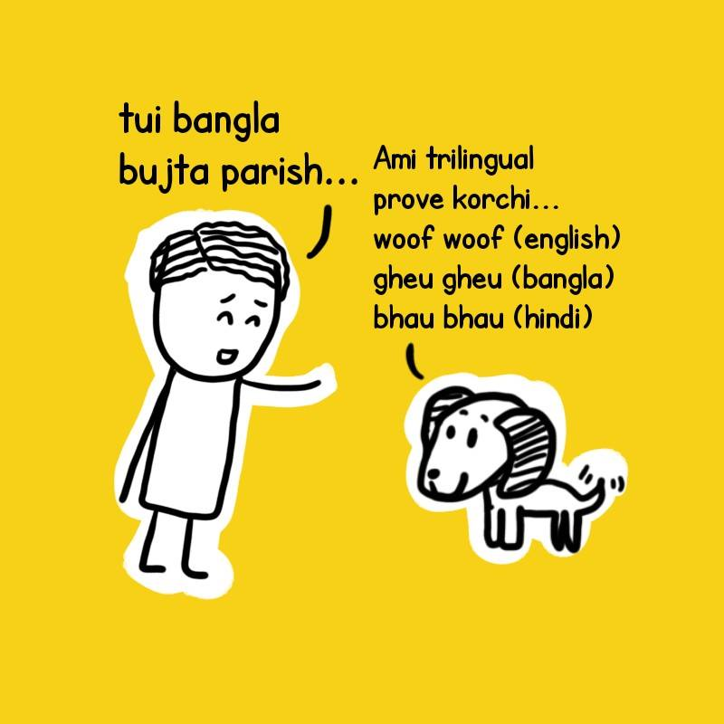
PROLOGUE

Slide 5
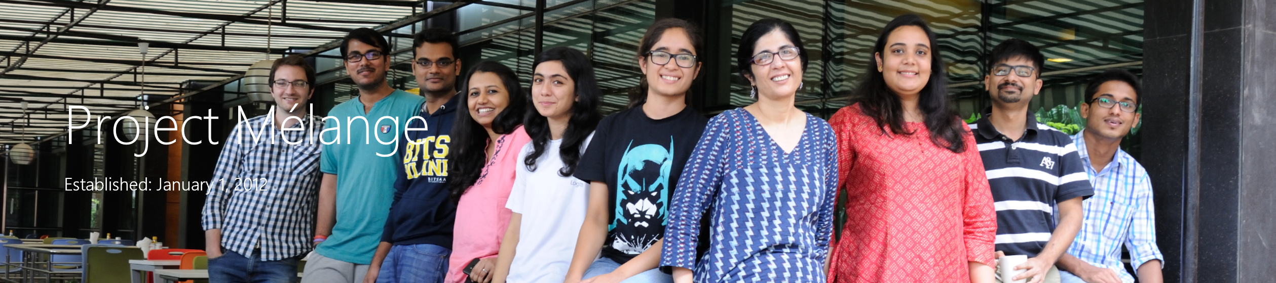
You are in safe hands ;p

Slide 6

Why this tutorial?
Code-mixing is hot right now!
Industry is interested
50% queries to Ruuh (Microsoft chatbot) are code-mixed
People are talking to Alexa in code-mixing
2-20% posts on Twitter and Facebook are code-mixed.
Number of papers in ACL anthology with code-mixing or related terms in the title or abstract.

Slide 7
After this tutorial, you will …
know how languages interact in multilingual societies
understand why code-mixing is a difficult (and therefore, interesting) problem
be able to appreciate the challenges and nuances of code-mixed dataset creation
have some idea about the different NLP tasks and research that has been happening
be able to make better and more informed decisions about designing code-mixed NLP systems

Slide 8
ML approaches and techniques for solving code-mixing are identical to those for monolingual NLP tasks. Differences exist in…
Priorities of tasks
Data collection and preparation strategies
Optimally use of existing resources
User-centric design of (code-mixed) NLP systems

Slide 9
Setting mixed expectations …
Text | ❒ Speech
Design | ❒ Implementation
Deep Linguistics | ❒ Deep learning
Map the field | ❒ Cover all research
Insights from industry | ❒ Building large scale systems

Slide 10
Outline
Prologue
Definitions & some linguistic primer
Challenges and Solutions
SOTA in NLP tasks
Data and Evaluation
Language Modeling and Word Embedding
Pragmatic and Social Functions
Epilogue
BREAK
(10:30 – 11:00)
Notes:
Data- evaluation: Accuracy at switch point is important (Utsab, Yaov)

Slide 11
What is code-mixing?
Definitions and some Linguistic primer

Slide 12
Mixing vs. switching
Matrix language defines the grammatical structure of the sentence/clause
Sub-clausal syntactic units from another language, called the embedded language, can be inserted within the matrix structure.
Code Switching: When matrix changes across sentences/clauses, but no embedding
Code Mixing: When there is an embedded language
Lawyer: Minal: Lawyer: Minal: Lawyer: | Minal-ji, aap smile karti rahi? Extra-friendly thi aap? [Ms. Minal, were you smiling and being extra-friendly] I was normal. What? I was normal. Normal. Khana-pina normal. Hasna [food and drink normal, smiling]

Slide 13
Language Interactions in Multilingual Society
Code-mixing
Fused lect
High = frequent
interleaving
Code-switching
Performance Integration
Multilingual Discourse
Loan words/borrowing
Low = infrequent interleaving
Low = distinct languages
High = same
language
Cognitive Integration

Slide 14
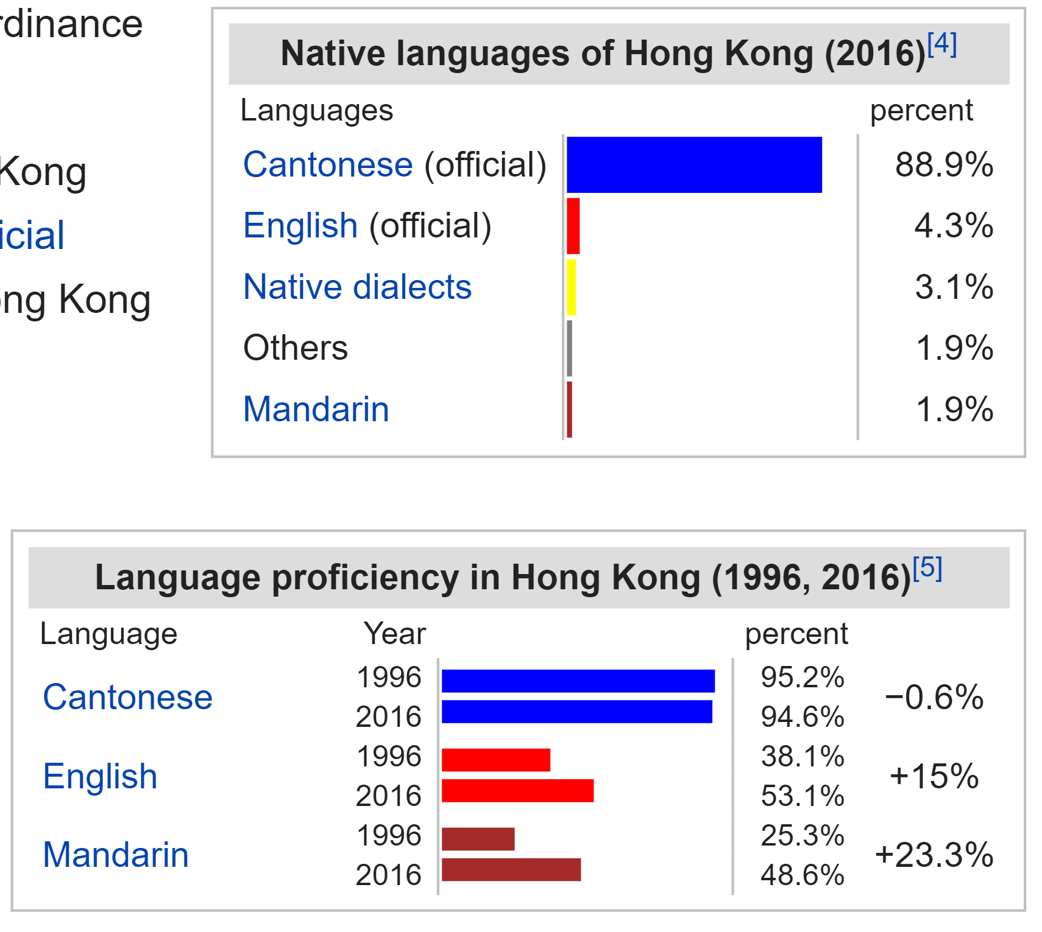
Societal Multilingualism
Source: Wikipedia

Slide 15
Code-mixing
Happens in all multilingual societies
Is predominantly a spoken language phenomenon
Is generally associated with informal conversations
Has well-defined socio-pragmatic functions

Slide 16
Why do we
CARE?
Challenges
& Solutions

Slide 17


Monolingual as well as Multilingual NLP systems break-down in the presence of code-mixing
Cortana, aaj Hyderabad ka weather kaisa hai? Is it raining ya sunny day hai?
Intersteller es una amazing movie!
Social Media Analytics
Adik… sem brape boleh bwak kenderaan? normal parent question – UiTMLendufornia

Slide 18
Hindi-English Code-Switching on Social Media
  In public pages from Facebook
  (of Indian celebrities, movies and BBC Hindi News)
    ALL sufficiently long threads were multilingual
    17.2% of the comments/posts have code-mixing
    Bali et al. I am borrowing ya mixing: An analysis of English-Hindi Code-mixing in Facebook. 1st Workshop on Computational Approaches to Code-switching, EMNLP 2014

Slide 19
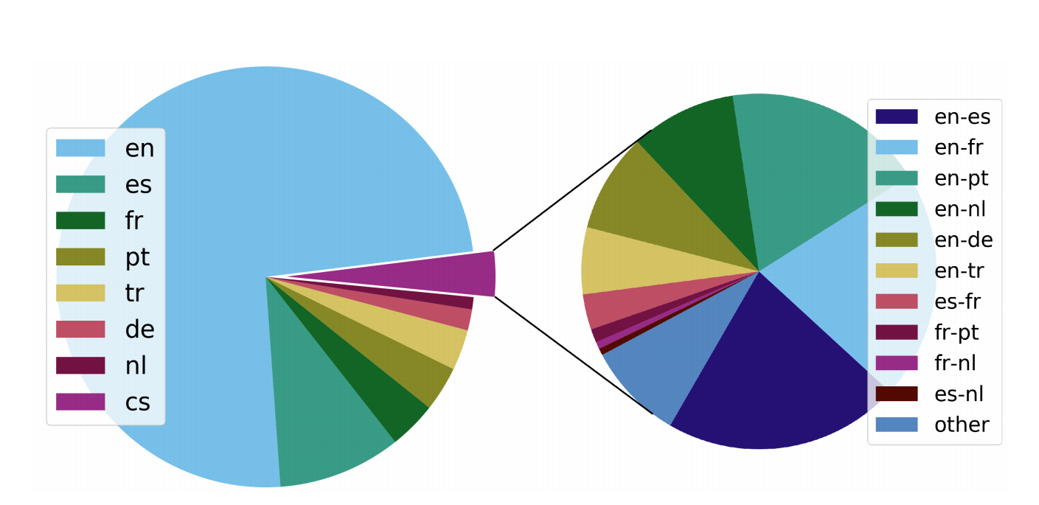
Rijhwani et al. ACL 2017
3.5% tweets are code-switched
Worldwide language distribution of monolingual and code-switched tweets computed over 50M Tweets (restricted to the 7 languages)

Slide 20
Geographical Distribution of Code-switching on 8M Tweets from 24 cities

Slide 21
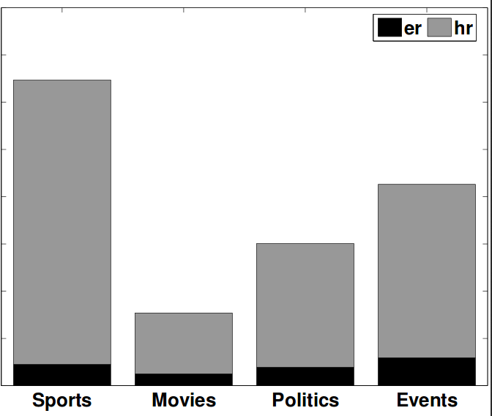
We might praise you in English, but gaali to Hindi me hi denge! (Rudra et al., EMNLP 2016)
Study of 830K Tweets from Hi-En bilinguals
The native language, Hindi, is strongly preferred (10 times more) for negativity and swearing
English is used far more for positive sentiment than negative
Language change often corresponds with changing sentiment
English
Hindi
Fraction of tweets with swear words

Slide 22
Inferences drawn from data in a single (usually the majority) language are likely to be misleading for multilingual societies.
Notes:
Because in multilingual societies if there is a language preference, if we use only one language in text processing for analysis, they are likely wrong.
For eg, looking at only english tweets for indian context, see a much more positive picture than it actually is

Slide 23
Why is it Challenging?
Problem of Data
Code-mixing is predominantly a spoken phenomenon.
So no large text corpora.
Model Explosion
With n languages, there are O(n²) potential code-mixed pairs.
Reusing Models
How to exploit the monolingual models and data for code-mixing.

Slide 24
How to solve it?
Combine monolingual models
Combine monolingual data
Use synthetic code-mixed data

Slide 25
Computational Models of Code-Switching
Supervised i.e., from scratch
Divide & Conquer
Combining Monolingual Models
Zero-shot learning
Annotated Code-mixed Data
Code-switched Model
Notes:
Data is a problem

Slide 26
Computational Models of Code-Switching
Code-switched Text or speech
Supervised i.e., from scratch
Divide & Conquer
Combining Monolingual Models
Zero-shot learning
LID
L1 fragment
L2 fragment
L1 model
L2 model
Vyas et al. 2014. En-Hi POS Tagging
Notes:
Dependency between fragments

Slide 27
Computational Models of Code-Switching
Code-switched Text or speech
Supervised aka from scratch
Divide & Conquer
Combining Monolingual Models
Zero-shot learning
L1 model
L2 model
LID
Solorio and Liu (EMNLP 2008): En-Es POS Tagging
Also Multilingual ASRs
Combination Logic or ML

Slide 28
Computational Models of Code-Switching
L1 Data
L2 Data
Supervised aka from scratch
Divide & Conquer
Combining Monolingual Models
Zero-shot learning
Code-switched Model
Schuster et al. 2016: Zeroshot translation with Google’s Multilingual Neural Machine translation System
Artexe and Shwenk. 2019: Massively multilingual sentence embeddings for zeroshot crosslingual transfer and beyond.
Notes:
But will it work? Human babies do so.

Slide 29
State-of-the
ART
Speech and NLP Tasks

Slide 30
Code-mixed Speech and NLP tasks
Code-mixed tasks
Speech
ASR
TTS
Text
Word level
Sentence level
Applications
POS Tagging
NER
Lang. Identification
Sentiment Analysis
Parsing
Question Answering
Machine Translation
Language Model
Information retrieval
Every Speech and NLP task that takes input beyond lexical information has a counter code-mixed task
  Sub-sentential , sentence, conversation etc.
  There are few tasks which address morpheme level code switching

Slide 31
Statistics of papers from ACL anthology that mentions Code-mixing, code-switching, etc., and for speech work also considering Interspeech and ICASSP

Slide 32
Language Identification
Microsoft | ne | ek | worldwide | Hackathon | organize | kiya
NE | Hi | Hi | En | En | En | Hi
The task is to label each word in a text with a language from a set L or a named entity
  Preprocessing for the downstream NLP tasks
  Techniques include
    Dictionary look up
    Sequence labelling approaches
Dilwale vs. Bajirao Mastani: Even Super-Films Get the Monday Blues
    Wat n awesum movie it wazzzz! sabko dekhna chahiye

Slide 33
Use of LID
Code-switched Text or speech
Code-switched Text or speech
L1 model
L2 model
LID
LID
L1 fragment
L2 fragment
L1 model
L2 model
Combination Logic or ML

Slide 34
Pairwise Language Labeling: Approach
Technique: Use your favorite Sequence Labeling technique
E.g., HMM, Conditional Random Fields, RNN
Data:
  EMNLP 2014 Code-Switching Dataset
  FIRE Language Detection Dataset

Slide 35
Semi-supervised Learning with Weak Labeling
(Technique: Hidden Markov Models)
Unlabeled Tweets
Monolingual (Labeled) Tweets
Initial Model
Finer Models

Slide 36
Initial Model from Weakly Labeled Data
Ge
XGe
Start
En
XEn
End
Fr
XFr

Slide 37
Updating the probabilities
Ge
0.05
0.04
0.8
0.79
0.015
En
XEn
End
En
XEn
End
0.14
0.15
0.015
Fr

Slide 38
Some examples
English
Other language
X
Correctly Labeled:
@crystal_jaimes no me lebante ahorita cuz I felt como si me kemara por dentro ! :o Then I started getting all red , I think im allergic a algo
What was your favourite moment at the concert ? Was war für euch der schönste Moment ?
Errors:
RT @lolsoufixe : remember when pensavam que a minha cadela aka nina se chamava Irina
XINGIE , nouvel de disponible dès aujourd'hui release party jeudi aux bains ...

Slide 39
Our current LID system can handle
25 Languages
Languages:
Dutch
English
French
German
Portuguese
Spanish
Turkish
Catalan Indonesian
Czech Italian
Danish Latvian
Estonian Malay
Finnish Norwegian
French Polish
Croatian Romanian
Hungarian Slovak
Tagalog Slovene
Word Labeling Accuracy
2 7 25
#Languages →

Slide 40


Machine Translation
Input | Translation
हाँ | मैं हायर एजुकेशन किया हूँ | haan . main haayar ejukeshan kiya hoon . | Yes I have higher ejayuukeshan.
मैं अभी तक शादी नहीं किया हूँ | मतलब अनमैरीड हूँ | main abhee tak shaadee nahin kiya hoon . matalab anamaireed hoon . | I'm not married yet. I mean Anamairid.
हम्म! एक्चुअली, क्रिकेट में मुझे अच्छा लगता हैं | hamm! ekchualee, kriket mein mujhe achchha lagata hain . | Hmm! Ekachualali Ahha, I feel good in cricket.
4-6%
Tweets are code-mixed found in Bing translation
The problem is more intense if the input is Romanized. Less intense if mixed script is used

Slide 41


Machine Translation for Code-mixed input
Merci beaucoup à tout le monde pour les messages. Grazie ancora per gli auguri
Fr → En
Thanks much to everyone for messages. Grazie ancora per gli wishes
Direct Translation
Language Detection
Merci beaucoup à tout le monde pour les messages.
Grazie ancora per gli auguri
In process of integration with Bing MT for 7 Languages
(En, De, Es, Pt, Fr, Tr, Du)
Fr→ En MT
It→ En MT
Thanks much to everyone for messages.
Thanks again for your good wishes.

Slide 42
MT for code-switching is hard problem!
  “… we can handle input with code-switching … In practice, it is not too hard to find examples where code-switching in the input does not result in good outputs; in some cases the model will simply copy parts of the source sentence instead of translating it.”
Google's Multilingual Neural Machine Translation System: Enabling Zero-Shot Translation
November, 2016

Slide 43
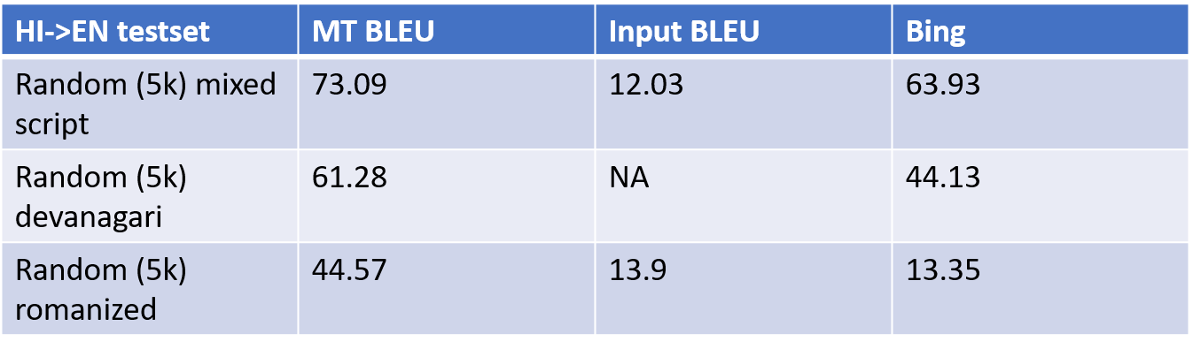
Machine Translation
Some insight of code-mixed translation with different script

Slide 44
How to test ?
Data
& Evaluation

Slide 45
The Three Fundamental Problems of CM DATA
/
Where to get the data form?
1
How to characterize the nature of code-mixing?
2
How to label the data given?
3

Slide 46
Where to get the data from?
Ideally, transcribed conversational speech
BANGOR-MIAMI: En-Es, 54 conversations
Next best is Text-based chat logs
WhatsApp and Facebook conversation
Privacy concern
SEAME (63 Hrs), HKUST (5+15 hrs), CECOS (12 Hrs), CUMIX (17 hrs): En-Mandarin
MCSM: French-Arabic
Malay-En, Frisian-Dutch, Hindi-English
Extracted Twitter conversations
Human-bot conversations

Slide 47
Where to get the data from?
Non-conversational text data
User generated content on the Web
Scripted conversations
Movie scripts
Twitter – most researched, but doesn’t allow distribution of tweet contents
Facebook – difficult to crawl
YouTube, Reddit comments
Plays, podcasts, reality shows

Slide 48
Guess Why?
POS tagging accuracies reported on the BANGOR-MIAMI (En-Es) corpus are in high 80s to mid 90s, whereas POS tagging accuracies of the best performing systems in the ICON 2017 shared task (En-Hi, En-Ta, …) was in mid-70s!
  More training data
  Inherently difficult language pair
  Patterns of code-mixing in the corpora are different

Slide 49
Language Interactions in Multilingual Society
Code-mixing
Fused lect
High = frequent
interleaving
Code-switching
Performance Integration
Multilingual Discourse
Loan words/borrowing
Low = infrequent interleaving
Low = distinct languages
High = same
language
Cognitive Integration

Slide 50
The Three Fundamental Problems of CM DATA
Where to get the data form?
1
How to characterize the nature of code-mixing?
2
How to label the data given?
3

Slide 51
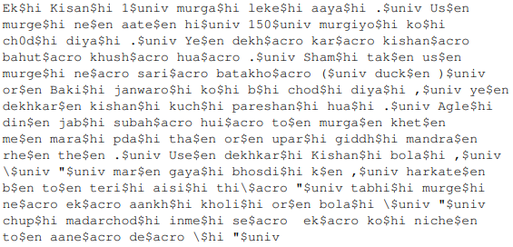

Comparing the level of code-mixing
fraction of words in matrix language is not a good estimator
(Gambäck and Das, 2014)

Slide 52


Comparing the level of code-mixing
$w_{L1}w_{L1}w_{L2}w_{L2}$
vs.
$w_{L1}w_{L2}w_{L1}w_{L2}$
$Uses number of code alternation points per token$
Extended this considering the code-alternation between two utterances
(Gambäck and Das, 2016)

Slide 53



Comparing the level of code-mixing
Ratio-based metrics
M-index (Barnett et al., 2000)– the ratio of languages in the corpora to measure the inequality of the distribution
Guzman et al., 2017
  Language Entropy #of bits needed to represent the distribution of languages
  I-Index – measure the total probability of switching in the corpus

Slide 54


Comparing the level of code-mixing
Time-course measure (Guzman et al., 2017)
  Measures the temporal distribution of C-S across the corpus
  Burstiness – Bursty vs periodic patterns
  Information required to describe the distribution of language span

Slide 55
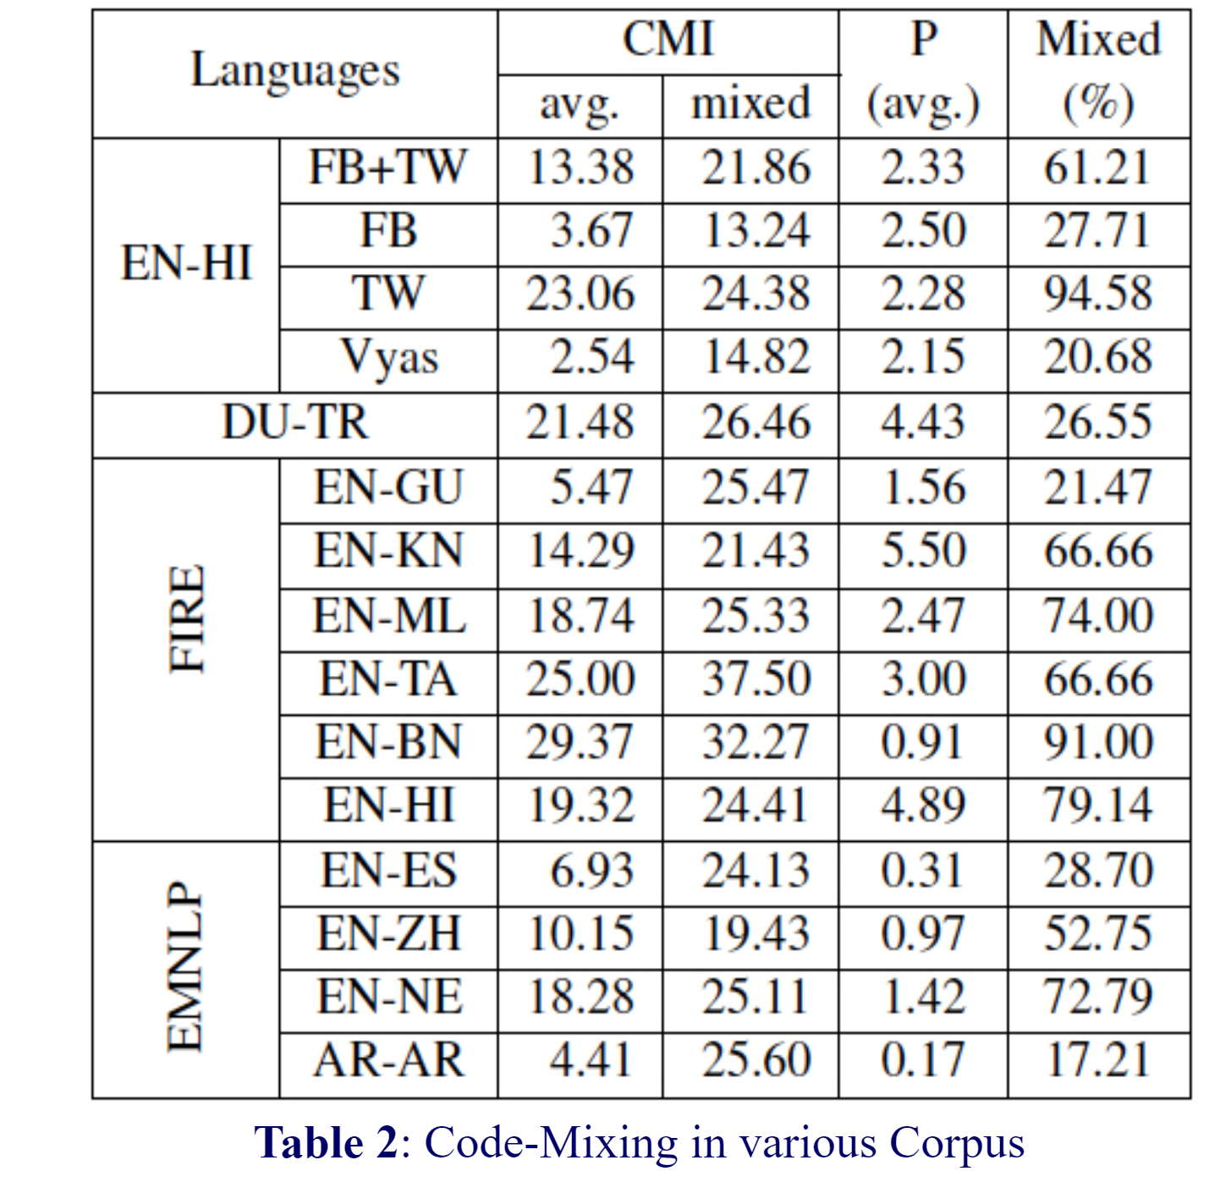
CMI of some Corpora
Source: http://www.amitavadas.com/Code-Mixing.html

Slide 56
The Three Fundamental Problems of CM DATA
Where to get the data form?
1
How to characterize the nature of code-mixing?
2
How to label data?
3

Slide 57
Annotation Standards
No special treatment needed for code-mixing
Sentiment, emotion, hate speech
Information retrieval
Machine translation
Monolingual standards need to be adapted
POS Tagging
Parsing
New standards need to be created
Word-level Language Detection
Discourse functions of code-mixing
ASR Transcription

Slide 58
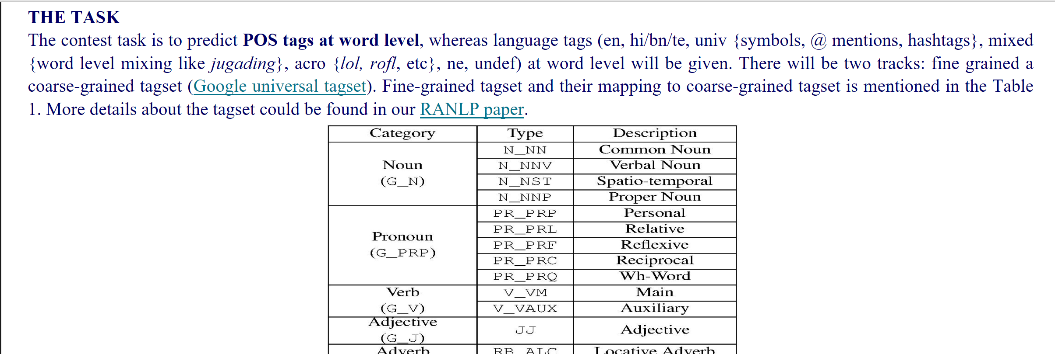
Are UNIVERSAL Tagsets for POS and Dependency labels adequate for code-mixed languages?
Source: http://www.amitavadas.com/Code-Mixing.html

Slide 59
Finding Annotators
It’s hard to find many bilingual turkers for a specific language pair, and impossible to find even one who knows all languages!

Slide 60
Evaluation of CM systems
Source: Utsab Barman (2019) Automatic Processing of Code-mixed Social Media Content. PhD Thesis. DCU
Evaluate at code-MIXING pointS

Slide 61
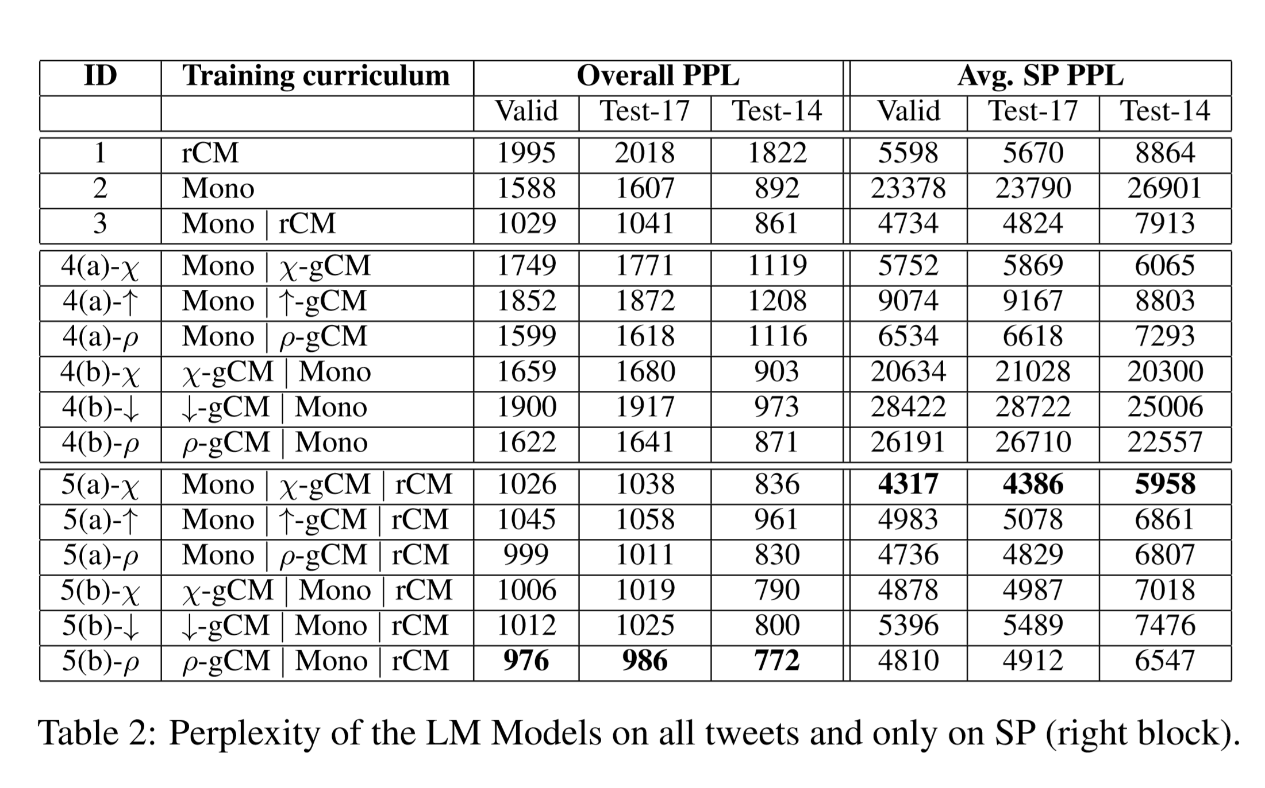
Evaluation of CM systems
Evaluate at Evaluate at code-mixing points
Language Modeling Perplexity
Source: Pratapa et al. ACL 2018

Slide 62
CODE-MIXING
Solving
Language Models and Word-Embeddings

Slide 63
What is Language Modeling
Assigning probabilities to sequences of words
$p\left(w_{1}w_{2}….w_{n}\right)= \prod_{k=1}^{n}{p\left(w_{k}\right|w_{k}w_{k−1}…w_{1}) }$

Slide 64
Why Language Modeling
Automatic Speech Recognition (ASR) systems need an LM
Downstream tasks like POS tagging, NER need some of form LM
The hot NLP topics now - Machine Translation and Language Generation also need LMs
And how can we forget phone keyboards?

Slide 65
Why Language Modeling
Say we have an LM that can properly code mix
  Model can predict words from both languages
  Model knows when to pick words from each language
  Model knows when to code mix
If so, have we solved the problem of code mixing itself??

Slide 66
Data ! Data ! Data !
Language | No. of Wikipedia Articles
English | 5.9 M
German | 2.3 M
French | 2.1 M
Chinese | 1.7 M
Esperanto | 270 k
Hindi | 133 k
LMs require large amounts of UNLABLLED data
  Unlike other NLP systems that can be trained on less LABELLED data
Monolingual LMs, trained on Wikipedia data
Code-Mixed Corpora | No. of Sentences
Hindi- English (Chandu, et al. (2018)) | 59 k
Mandarin – English (SEAME) | 56 k

Slide 67
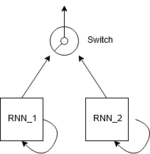
Approaches: Something Simple
1 RNN per language
Take turns outputting tokens
Which RNN’s turn – determined by a switch variable
Switch variable sampled from some distribution
Garg et al. (2017) Dual Language Models for Code Switched Speech Recognition.

Slide 68
Approaches: More Complex
Handle Data Sparsity
  Generate more code-mixed sentences
Model the switching constraint
  Make the model learn when to switch
Share context between both RNNs

Slide 69

One approach to handing data sparsity
Language modeling for code-mixing: The role of linguistic theory based synthetic data, Pratapa et al. [2018]

Slide 70

Use Linguistic Theories ??
These theories exist as early as 1980s
Assume a syntactic relation between a pair of parallel sentences
  Equivalence of grammar rules
  Word or phrase level alignment
Propose ways to model CM and generate sentences
Sentences generated with a linguistic theory backing – Bound to be better than random mixing

Slide 71

Linguistic Theories for CM
The 3 theories
  Equivalence Constraint (Sankoff and Poplack [1981]), (Sankoff [1998])
  Functional Head (Belazi et al. [1994])
  Embedded Matrix
Li and Fung. 2014. Code switch language modeling with functional head constraint used the functional head theory during the decoding phase of the LM component of the ASR

Slide 72
Example
She lives in a white house
Elle vive en una casa blanca

Slide 73
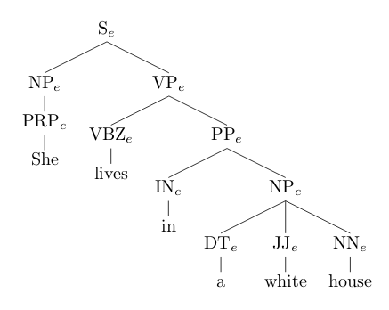
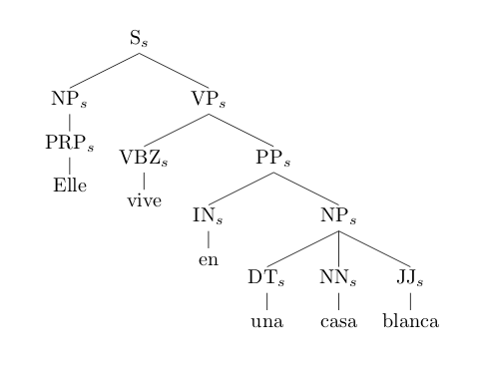
EM theory
Replace a subtree in the matrix language with one from the embedded language
She lives in a white house
Elle vive una casa blanca

Slide 74
EM theory
in a white house
Elle vive una casa blanca

Slide 75
EM theory
Elle vive in a white house

Slide 76
EC theory
All leaf nodes swappable
After all swaps, check for constraints
  Monolingual fragments must appear as in original language
  EC constraint must be obeyed at every switch point
    Each node in the tree is assigned a language id from it’s parent and children
    Parent: Based on ordering of NTs in RHS of rule applied at parent
    Child: Based on language of leaf and propagated upwards
    Both have to match

Slide 77
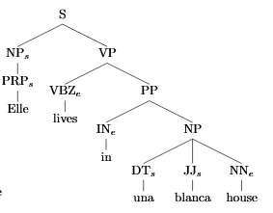
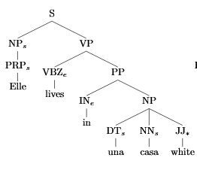

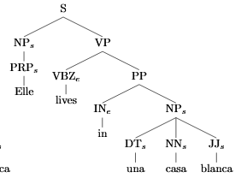

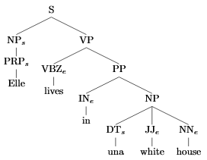

English
Spanish
Ill-formed Monolingual Fragment
Language tag mismatch
Code Mixed

Slide 78
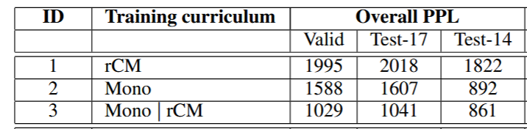
Training via a Curriculum
Use of curriculum improves perplexity of the model
Baheti, et al. (2017) Curriculum Design for Code-switching: Experiments with Language Identification and Language Modeling with Deep Neural Networks – using a curriculum improves perplexity
  Monolingual -> Code Mixed
Pratapa, et al. (2018)
  Generated Code Mixed -> Monolingual -> Real Code Mixed
  Adding Real Code Mixed at the end is very useful
Results from Pratapa, et al. (2018) on LM Perplexity

Slide 79
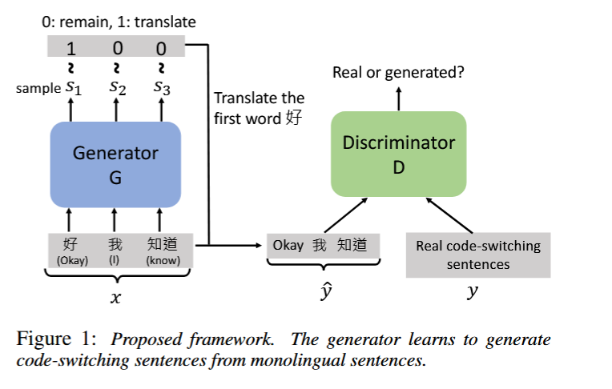
Other Work - Handle Data Sparsity
Models that are trained on data generated by a SeqGAN
  Garg, et al. (2018) Code-switched Language Models Using Dual RNNs and Same-Source Pretraining
  Chang, et al. (2019) Code-switching Sentence Generation by Generative Adversarial Networks and its Application to Data Augmentation
Chang, et al. (2019) GAN framework for generating sentences

Slide 80
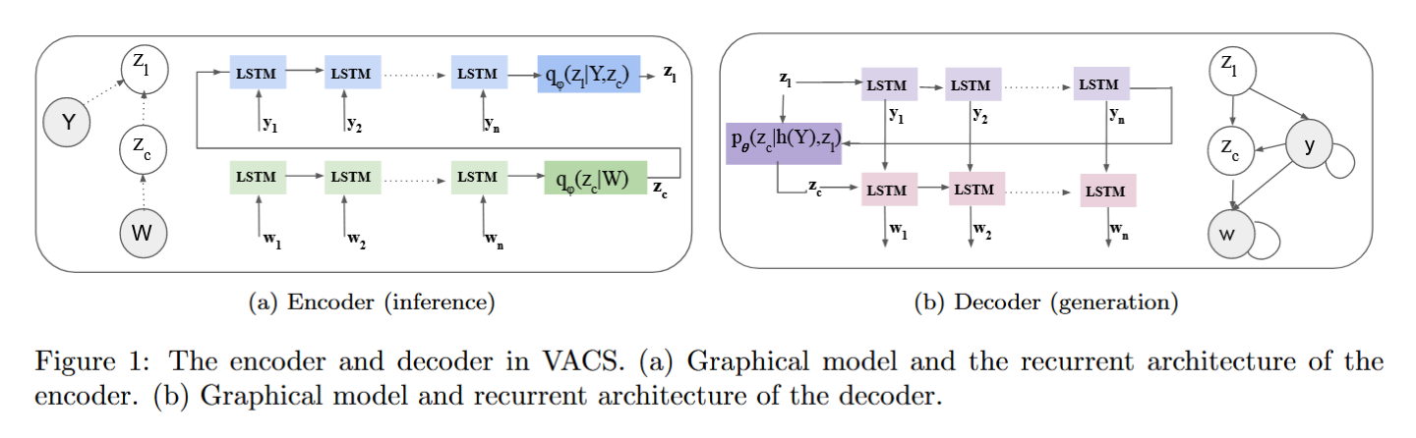
Other Work - Handle Data Sparsity
Samanta, et al. (2019) A Deep Generative Model for Code-Switched Text present using VAEs with a RNN based encoder and decoder to generate sentences
Samanta, et al. (2019), A VAE framework for generating sentences

Slide 81
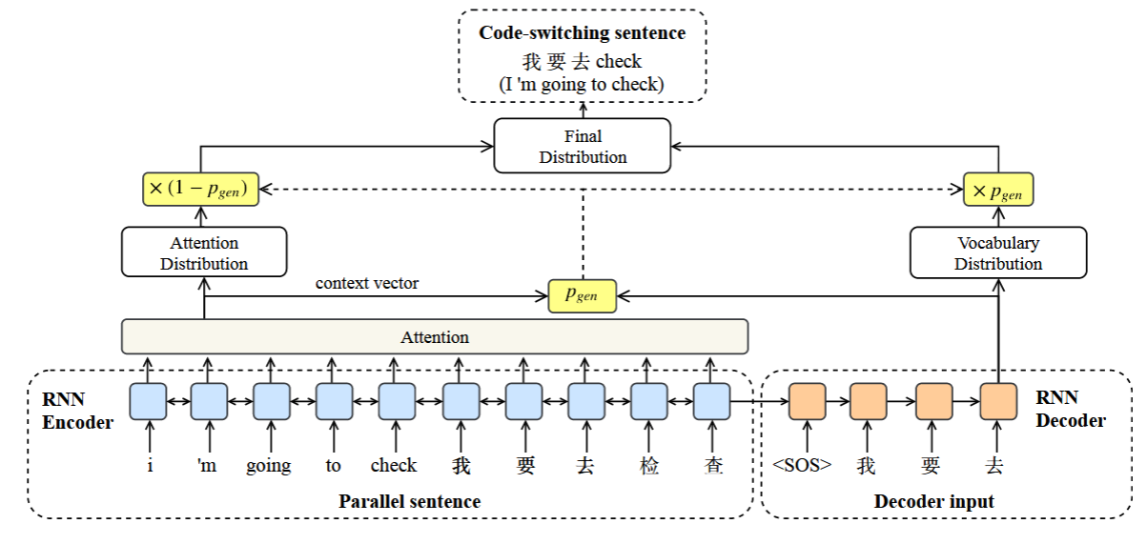
Other Work - Handle Data Sparsity
Winata, et al. (2019) Code-Switched Language Models Using Neural Based Synthetic Data from Parallel Sentences use pointer generator networks to generate code mixed sentences
Lee, et al. (2019) Linguistically Motivated Parallel Data Augmentation for Code-switch Language Modeling use the EM theory at a phrase level to generate code mixed sentences
Pointer Generator networks used in Winata, et al. (2019)

Slide 82
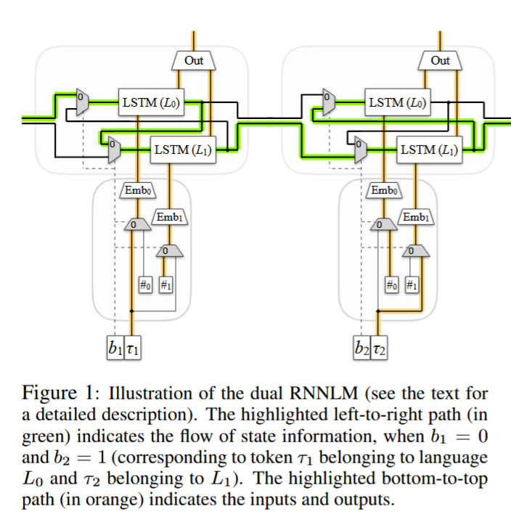
Other Work - Model the switching constraint
Garg, et al. (2018) Code-switched Language Models Using Dual RNNs and Same-Source Pretraining
  Output of 2 RNNs run through linear layer to get final output
  Also train on data generated by a SeqGAN

Slide 83
Other Work - Model the switching constraint
Adel, et al. (2013) Combination of Recurrent Neural Networks and Factored Language Models for Code-Switching Language Modeling
Adel, et al. (2015) Syntactic and semantic features for code-switching factored language models

Slide 84
Other Work - Model the switching constraint
Winata, et al. (2018) Code-Switching Language Modeling using Syntax-Aware Multi-Task Learning show that adding a POS tag prediction task to the LM shows improvements in perplexity
Soto and Hirschberg (2019) Improving Code-Switched Language Modeling Performance Using Cognate Features uses features about words with similar origin in both languages

Slide 85
Other Work – Sharing context between the RNNs
Not as simple of a task as it sounds
No current model capable of this
On a related note
  Multilingual deep contextual embeddings – models multiple languages at once
  Can this be made to code mix?
  Artetxe, and Schwenk. (2019) Massively multilingual sentence embeddings for zero-shot cross-lingual transfer and beyond has an explicit language id as input in decoder during training

Slide 86
Talking about embeddings…

Slide 87
Work on Embeddings for code mixing
Most work - Bilingual Embeddings adapted for some tasks
What about learning embeddings from CM data?

Slide 88
Bilingual Embeddings
Summarized in Upadhyay et al., (2016)
4 methods
  Bilingual Skip-Gram Model (BiSkip) - Luong et al. (2015)
  Bilingual Compositional Model (BiCVM) - Hermann and Blunsom (2014)
  Bilingual Correlation Based Embeddings(BiCCA) - Faruqui and Dyer(2014)
  Bilingual Vectors from Comparable Data(BiVCD) - Vulíc and Moens(2015)
Take monolingual embeddings and a corpora aligned at certain level
Projects those embeddings into a common space using the alignment

Slide 89
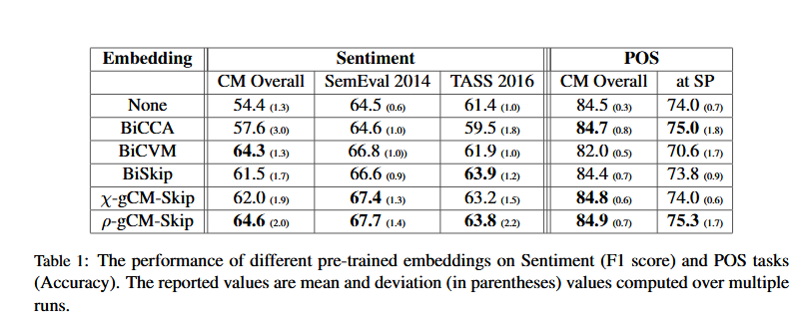
Bilingual Embeddings for CM
Pratapa, et al. (2018) evaluated these for CM POS tagging and sentiment analysis
Pre-trained embeddings performed better than no embeddings
Embeddings learnt on synthetic code mixed data performed better

Slide 90
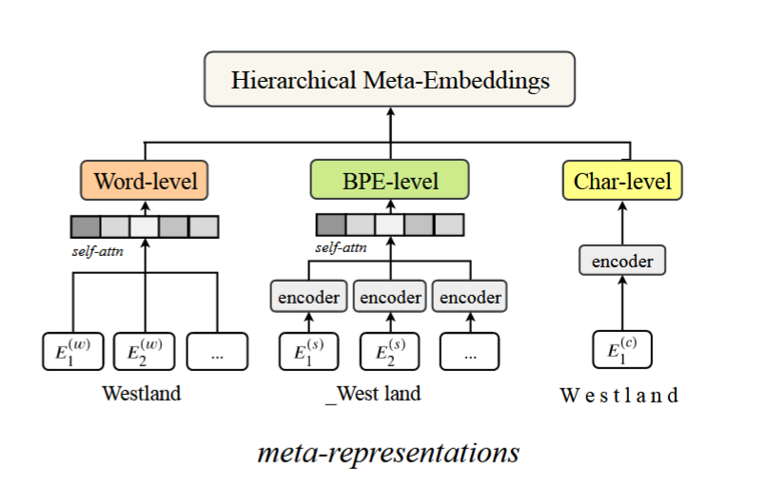
Other work on Embeddings
Winata, et al. (2019) Hierarchical Meta-Embeddings for Code-Switching Named Entity Recognition show that amalgamating multiple embeddings(word, subword, and character level) shows improvements in downstream tasks
Lee and Li. (2019) Word and Class Common Space Embedding for Code-switch Language Modelling show that when using auxiliary features as input for an LM, constraining the embedding space of the words and these features improves LM perplexity
Winata, et al. (2019)

Slide 91
Takeaways
So much is possible using linguistic theories
Solving LM for CM – solving CM
Direction of Future Work
  Deep contextual embeddings ?
  Zero shot transfer ?

Slide 92
Why do we
CODE-MIX?
Socio-pragmatic Functions of Code-mixing

Slide 93
Language Preference:
When and why do bilinguals prefer a certain language?
Topic change
Puns
Emphasis
Emotion
Reported Speech
But it’s unpredictable!
Notes:
Bilinguals have the choice between speaking in a single language as well as alternating languages in a conversation.
when and why do bilinguals prefer a certain language?
Several possible reasons have been observed in linguistics, for instance …
Identifying language preference is a challenging problem, because, in general, it’s rather unpredictable.

Slide 94
Linguistic Studies
Fishman (1971):
Use of English for professional settings, Spanish for informal chat
Dewaele (2004, 2010):
The native language elicits stronger emotion
Preferred for emotion expression and swearing
Nguyen (2014):
Code-choice as a social identity marker
Until recently, no large-scale, data-driven validation of the hypotheses.
Notes:
There have been linguistic studies on the subject of language preference since as early as 1971, when Fishman studied Spanish-English bilinguals in Puerto Rico. It was observed that English primarily featured in professional settings, while Spanish dominated informal conversation.
A few decades later, Dewaele hypothesized that the native (or the primary) language elicits stronger emotion and is therefore used to express sentiment and for swearing.
So, we have these studies that make certain claims about language preference – what’s missing?
Unfortunately, …

Slide 95
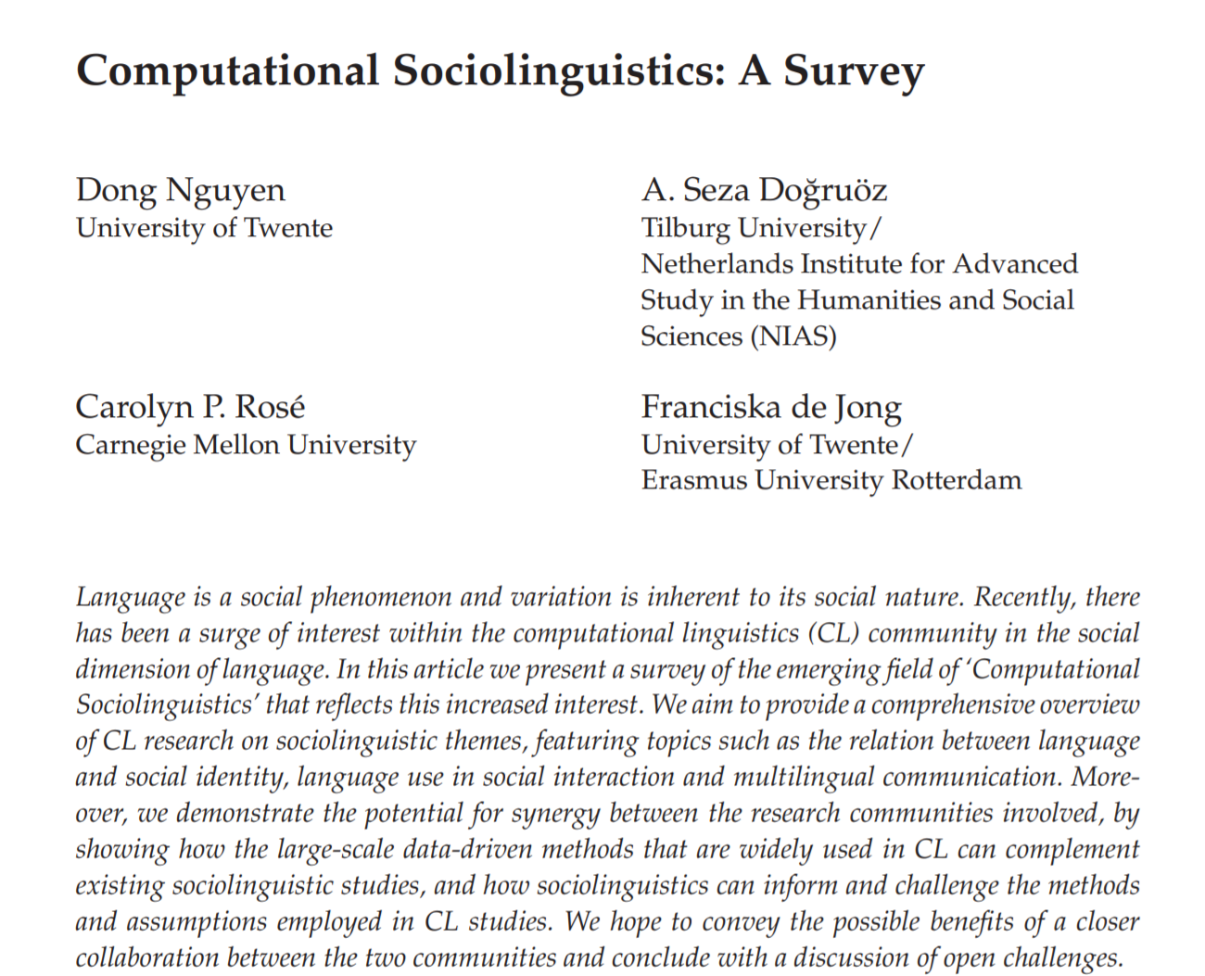
A great place to start your exploration!
Computational Linguistics, 2016

Slide 96
Initial quantitative studies
Jurgens, Dimitrov, and Ruths (2014) studied tweets written in one language but containing hashtags in another language
Nguyen, Trieschnigg, and Cornips (2015) studied users in the Netherlands who tweeted in a minority language (Limburgish or Frisian) as well as in Dutch. Most tweets were written in Dutch, but during conversations users often switched to the minority language (i.e., Limburgish or Frisian).

Slide 97
We might praise you in English, but gaali to Hindi me hi denge! (Rudra et al., EMNLP 2016)
Study of 830K Tweets from Hi-En bilinguals
The native language, Hindi, is strongly preferred (10 times more) for negativity and swearing
English is used far more for positive sentiment than negative
Language change often corresponds with changing sentiment
English
Hindi
Fraction of tweets with swear words

Slide 98
Predicting Naij́a-English code switching
Innocent Ndubuisi-Obi, Sayan Ghosh and David Jurgens (2019) W´etin dey with these comments? Modeling Sociolinguistic Factors Affecting Code-switching Behavior in Nigerian Online Discussions. ACL.
330K articles and accompanying 389K comments labeled for code switching behavior

Slide 99
Predictive Factors of Naij́a usage
Article Topic
Social Setting
number of prior comments
Depth of thread
Social Status – Number of followers
Emotion
Tribal affiliation: Yoruba, Hausa-Falani, Igbo, etc. (automatically labeled)

Slide 100
Predictive Factors of Naij́a usage
(Findings)
Article Topic
Social Setting
number of prior comments
Depth of thread
Social Status – Number of followers
Emotion
Tribal affiliation: Yoruba, Hausa-Falani, Igbo, etc. (automatically labeled)
Comments deeper in a reply thread are more likely to be Naij́a
Those made in the evening likely to be conversational with a particular person.
High status → more English, but potential confounds
Strong sentiment → more Naij́a

Slide 101
Rijhwani et al. ACL 2017
3.5% tweets are code-switched
Worldwide language distribution of monolingual and code-switched tweets computed over 50M Tweets (restricted to the 7 languages)

Slide 102
Geographical Distribution of Code-switching on 8M Tweets from 24 cities

Slide 103
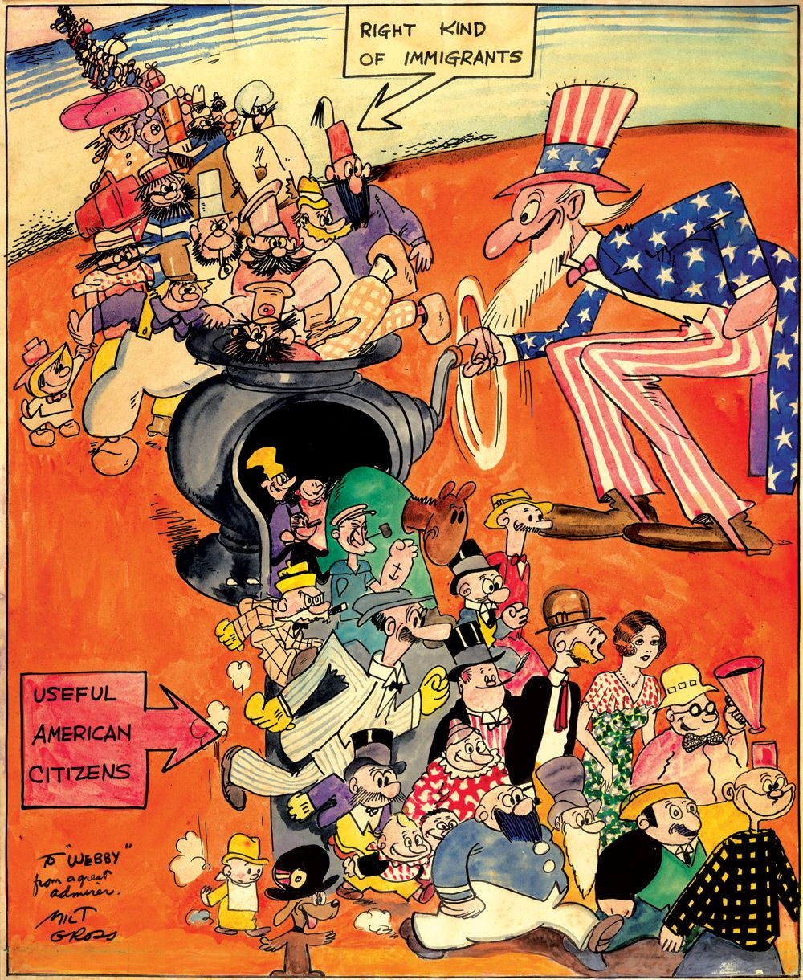
Fraction of monolingual English tweets is strongly negatively correlated (-0.85) with the fraction of code-switched tweets
This is surprising … especially for extremely multilingual US cities (e.g., Houston)
(?) ACCULTURIZATION takes place much faster in the US

Slide 104
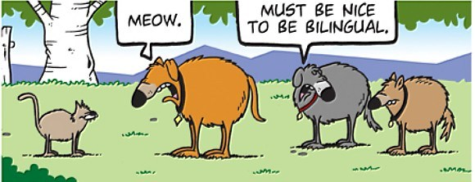
EPILOGUE
If bots could code-mix…

Slide 105


Code-choice as a Style dimension
VIJAY: ek minute ke liye thoda practical socho.
VIJAY: Main tumharey angle se hi soch raha hoon...
Tum hi uncomfortable feel karogi...
bahut time ho gaya hai... bahut fark aa gaya hai
RANI: Kismein? Mujhmein koyi change nahin hai
VIJAY: Vohi to baat hai... mujhmein hai... Meri duniya ...
bilkul alag hai... ab... you’ll not fit in
RANI: Matlab? ek dum se main tumharey jitni fancy nahin hoon...

Slide 106
Code-choice accommodation in human-human conversations
Base Rate of a style: How frequently a style (code) is used by a user
Style Accommodation: How frequently a style (code) is used by a user when the preceding utterance contain that style (code)
Bawa et al. Workshop on Computational Approaches to Code-Switching, EMNLP 2018

Slide 107
Nudge, don’t push or assume...
Human-human conversations show “positive accommodation” for the choice of the marked code
In a wizard-mediated-bot experiment, most users show a very strong preference for bot that can code-mix
A small fraction of users have negative opinion towards a code-mixing bot, so it is important to nudge before mixing.

Slide 108
Understanding code-mixing is not a luxury but a necessity for chatbots for multilingual societies

Slide 109
Resources
Sitaram et al. (2019) A Survey of Code-switched Speech and Language Processing. Arxiv. https://arxiv.org/abs/1904.00784
https://github.com/gentaiscool/code-switching-papers
Project Melange: https://www.microsoft.com/en-us/research/project/melange
Please get in touch with us for a comprehensive list of datasets and resources covered in this tutorial.

Slide 110
Tutorial me ane ke lie thank you! https://www.microsoft.com/en-us/research/project/melange/

